Slide 1
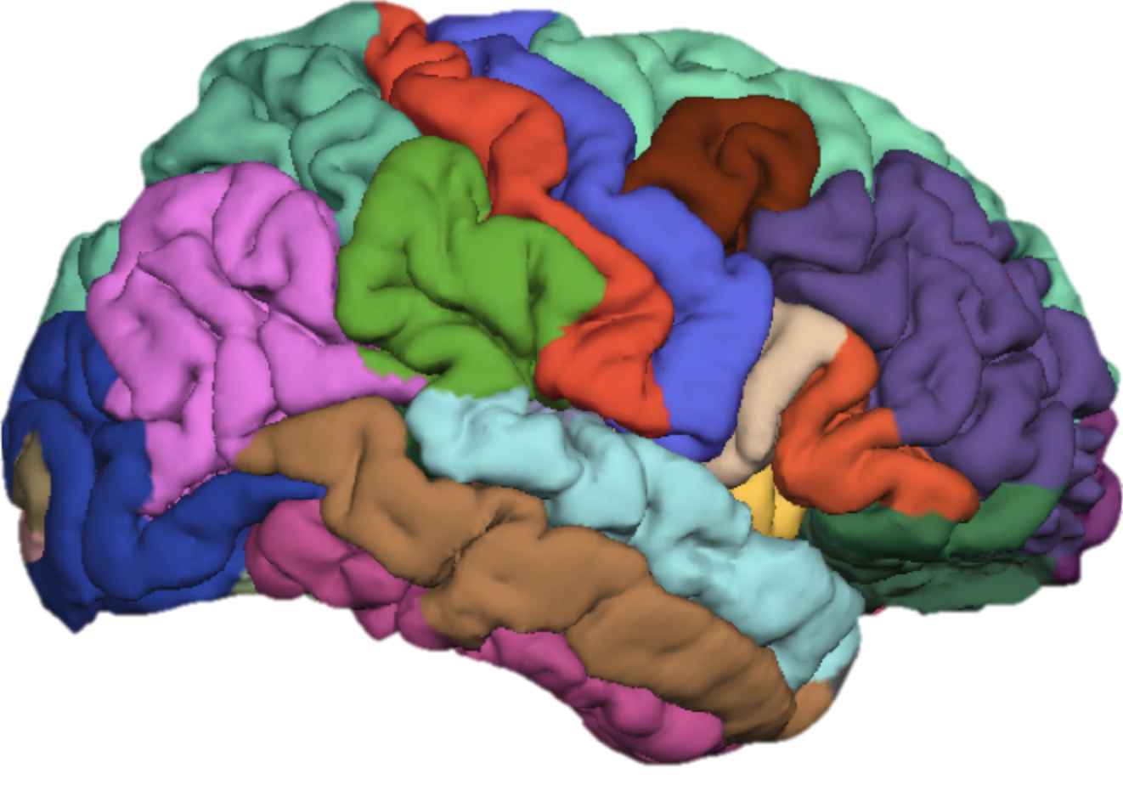
FreeSurfer Class 1: Introduction to the recon-all pipeline
Cat Camacho
1/9/17
11:00am-12:30pm
Notes:
Why pay $900 to hear an expert when you can listen to a novice for free?

Slide 2
Resources
Class GitHub repository
https://github.com/catcamacho/freesurfer_class
Contains slides, class bin, and practice brains
FreeSurfer Wiki
https://surfer.nmr.mgh.harvard.edu/fswiki/FreeSurferWiki
FreeSurfer mailing list
http://mail.nmr.mgh.harvard.edu/mailman/listinfo/freesurfer
Class mailing list: mood-freesurfer-class@lists.stanford.edu
Notes:
http://www.freesurfer.net/fswiki/CourseDescription

Slide 3
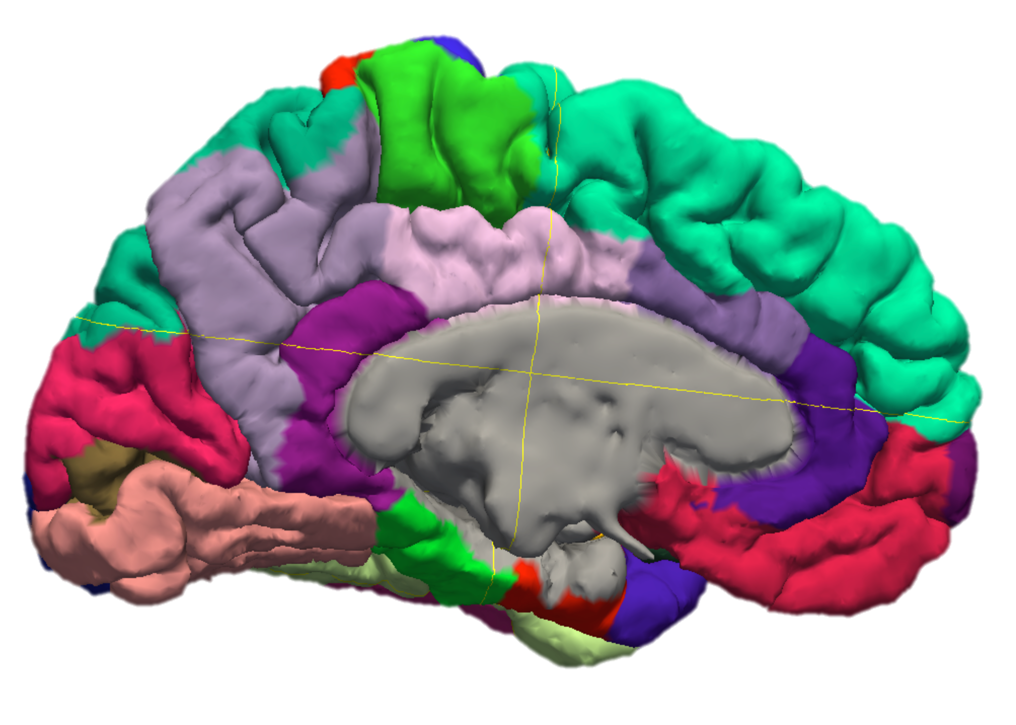
Goals for Today
By then end of today you will hopefully have basic knowledge of:
MRI T1w imaging
FreeSurfer architecture
Installation and interaction
Running full recon-all

Slide 4
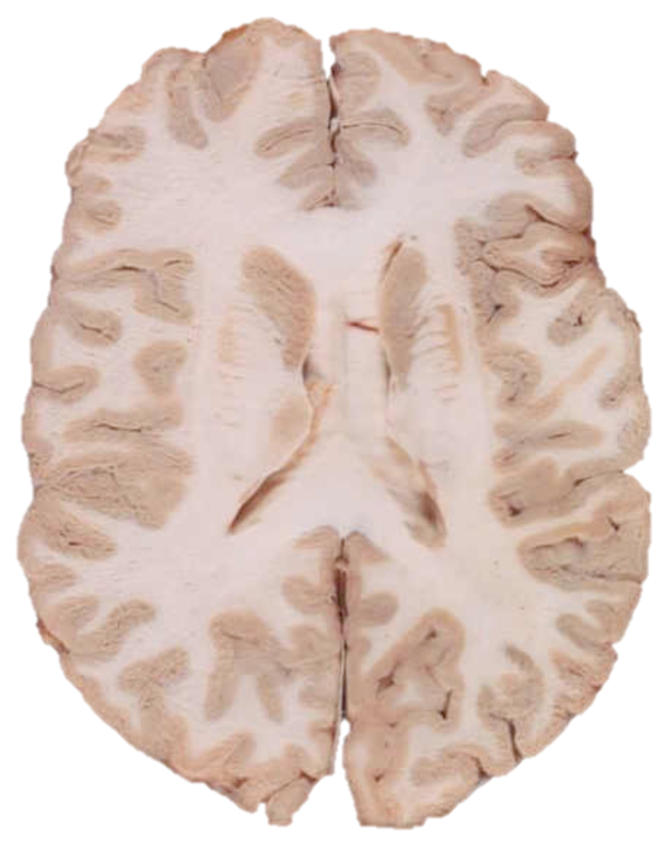
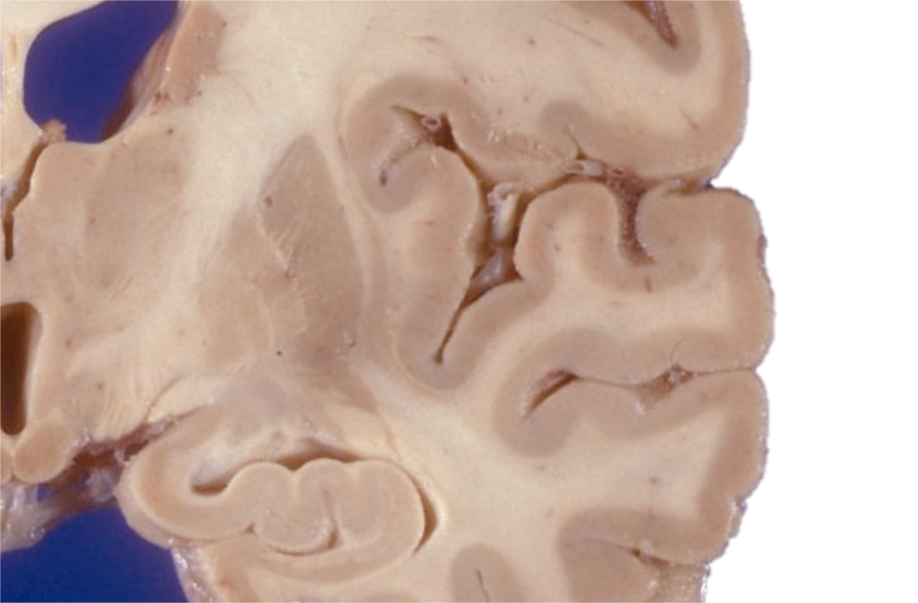
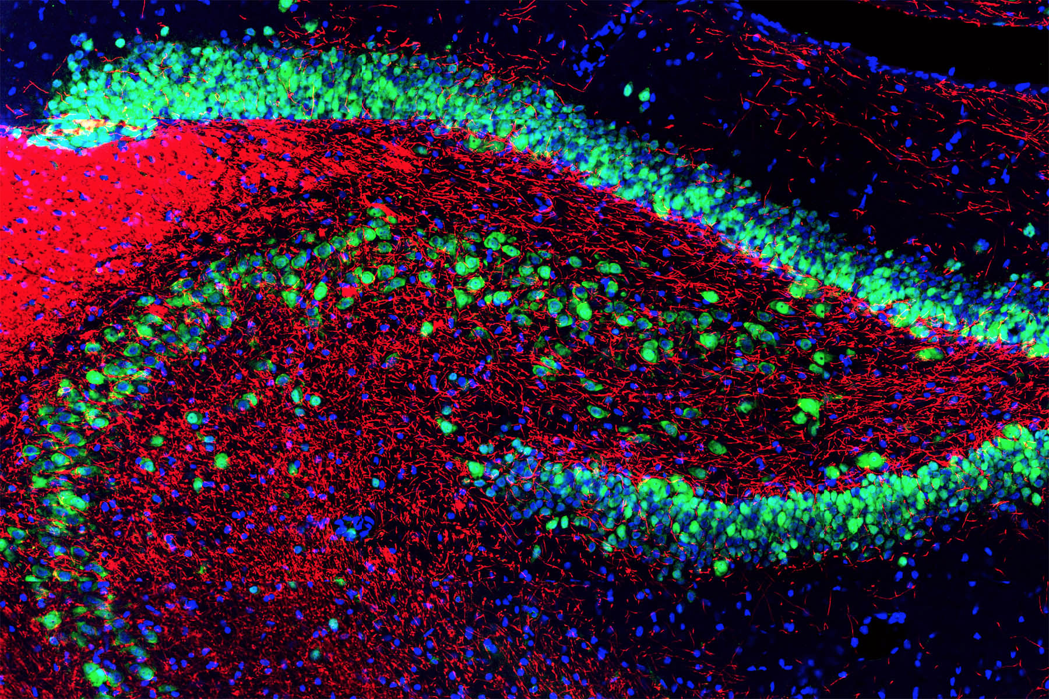
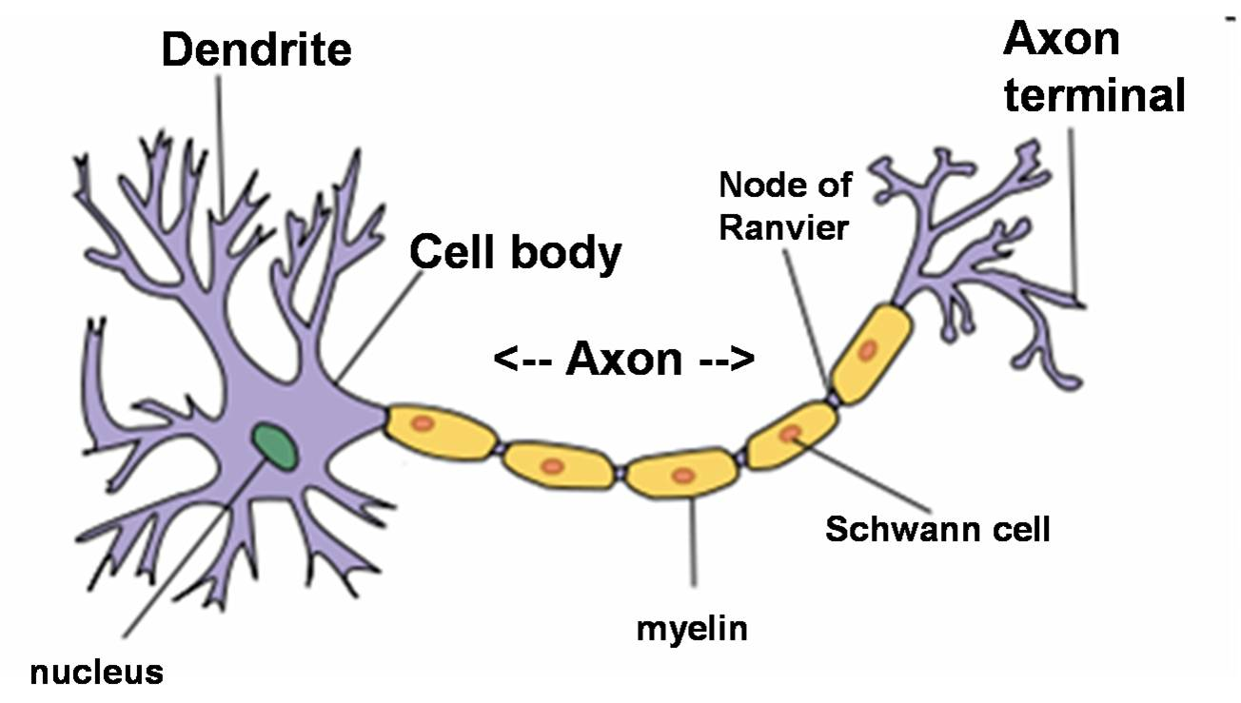
The Brain
White Matter
Gray Matter
The brain comprises different tissue types broadly defined as white matter (fatty, myelinated axons) and gray matter (not-as-fatty cell bodies)
Notes:
Pictures taken from a Google image search.
Rat hippocampus staining image from EnCor website (they sell antibodies and protein staining stuff)

Slide 5
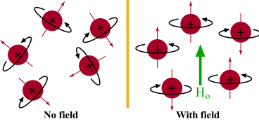
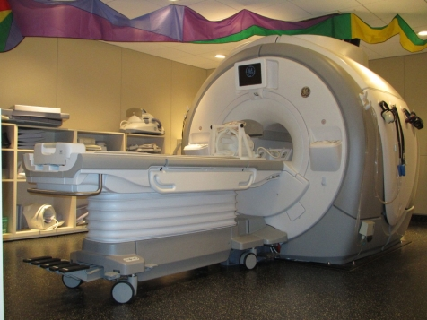
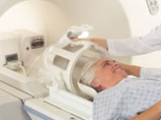
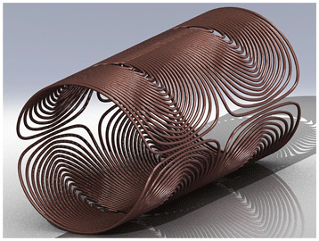
How does an MR scanner work?
The scanner is always measuring protons:
Protons align with the magnet upon entry
The RF coils in the scanner send pulses to excite the protons (making them spin)
The receiving coil records proton relaxation time

Slide 6
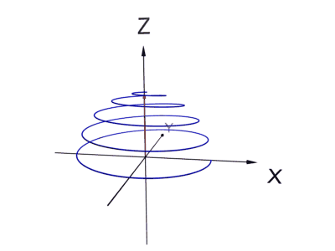
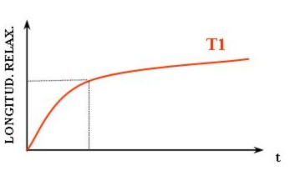
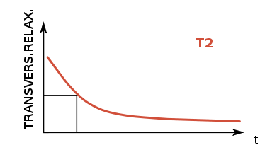
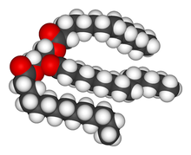
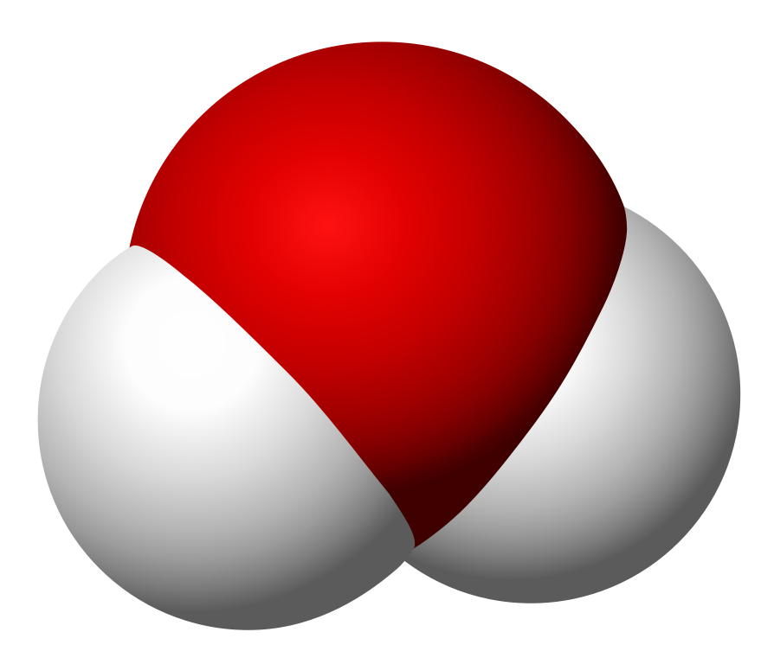

Relaxation Time: Clue to Tissue Content
T1
spin-lattice (or longitudinal)
T2
spin-spin (or transverse)
The time it takes for the proton to flip back in place relative to the baseline magnetic field measured longitudinally (Z direction below)
The time it takes for the proton to align back to the baseline magnetic field measured perpendicular to the field (X direction below)
These values are constrained by proton context (e.g. the molecular structure):
T2w
T1w
Watery tissue
Increasing proton density
(or decreasing water content)
Fatty tissue
Notes:
More detailed videos: https://med.stanford.edu/bmrgroup/education/mri-physics.html
NMR images taken from wikipedia: https://en.wikipedia.org/wiki/Nuclear_magnetic_resonance

Slide 7
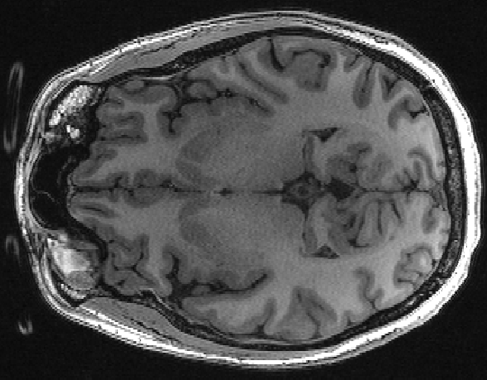
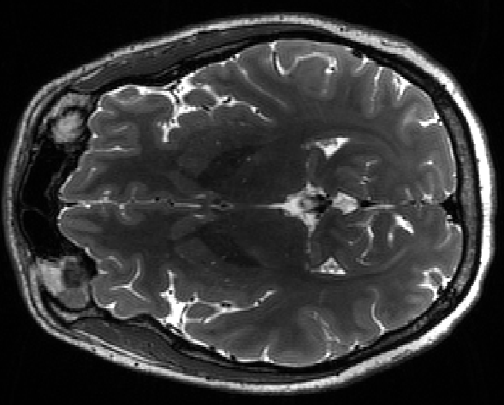
T1-weighted MR Imaging
T1w imaging basically creates a tissue map of a brain based on these principles:
Dense organized protons (like WM) will snap back quickly (around 100-150ms)
Less dense protons (like cerebrospinal fluid) takes longer to realign to baseline magnetization (1500-2000ms)
*Note: these ranges are different for T2w imaging because T2 is always shorter than T1 for a given tissue.
T1w Image
T2w Image
0-3000ms
0-1000ms

Slide 8
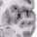
Images vs. Reality
Real Tissue
Imaged Tissue*
The resolution of MRIs is limited by many factors resulting in images that are not as detailed as the real thing (note the fuzzy edges above)
This is especially important to remember when studying small structures (most human MRI studies are ~1mm³ voxels)
*Not actually imaged- exaggeratedly pixelated for learning purposes.

Slide 9
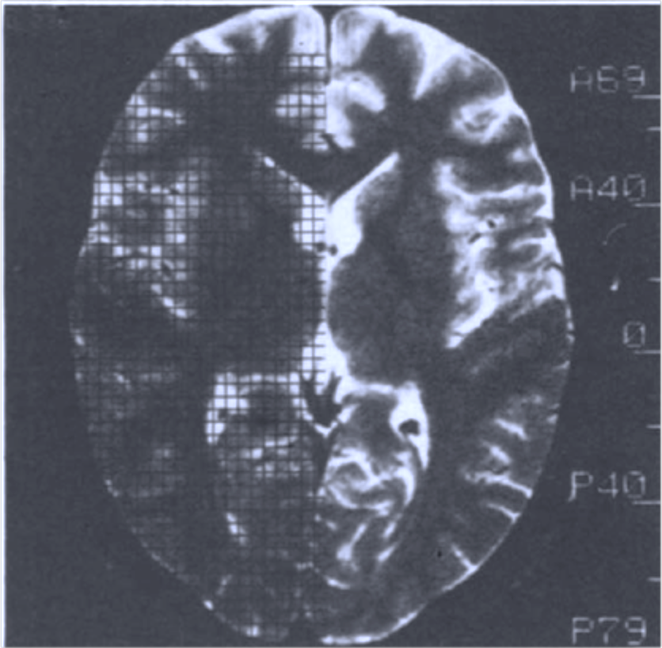
Quantifying MR Images
Proof technology makes life easier:
Early MRI days: manual tracing + grids to determine slice by slice area (top left)
Recent MRI days: manual tracing + computer program to calculate voxel count (bottom left)
Still common for small samples (and specific ROIs)
These days: automatic whole brain segmentation is common and saves lots of time!
Husain 1991 PRN
Parashos 1998 PRN

Slide 10
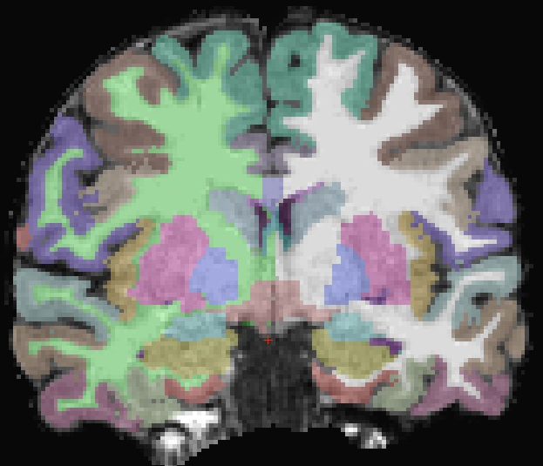
FreeSurfer
Takes raw T1w MR images and performs:
Artifact-correction
Skull-stripping
Whole brain segmentation
Cortical surface parcellation
Citation:
Fischl, B., Salat, D. H., Busa, E., Albert, M., Dieterich, M., Haselgrove, C., … Smith, S. (2002). Whole brain segmentation: automated labeling of neuroanatomical structures in the human brain. Neuron, 33(3), 341–55. http://doi.org/10.1016/S0896-6273(02)00569-X

Slide 11
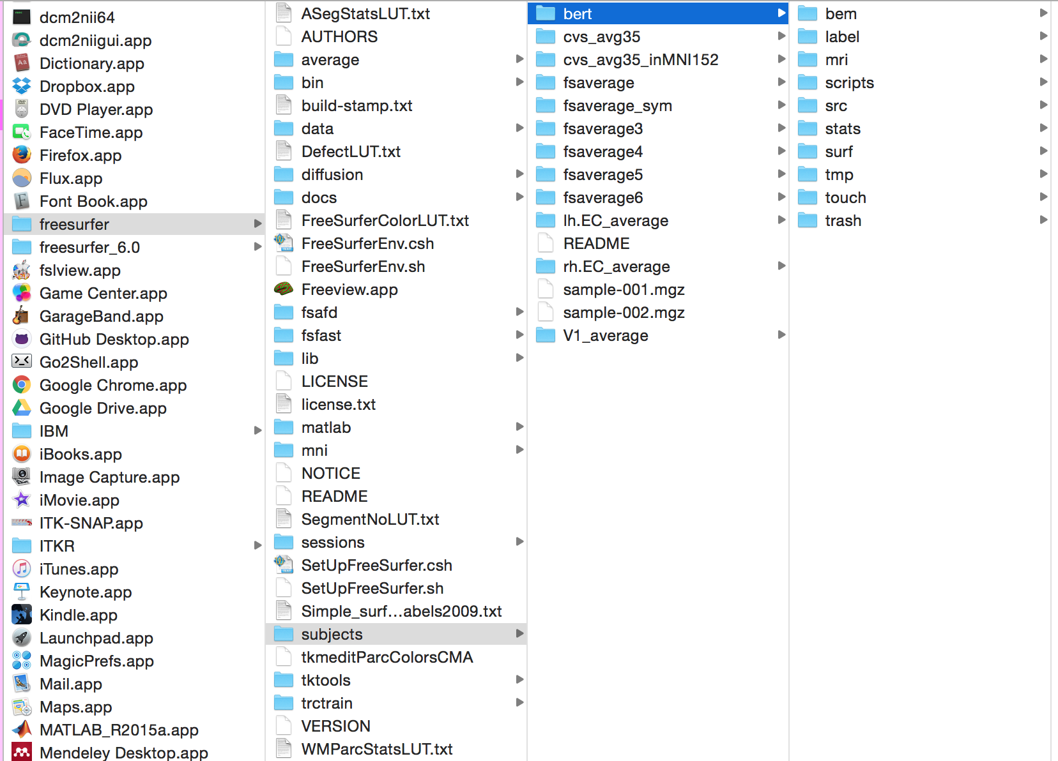
Program Architecture
Freesurfer lives in your Applications folder in one neat package (/usr/local for Linux)

Slide 12
Program Architecture
Notable folders/files:
bin- contains all freesurfer commands. Great place to add your own stuff!
subjects- default directory for data output. Contains a sample subject named Bert.
matlab- matlab scripts for some processing options (e.g. hippocampal segmentation)
*LUT.txt – These tables determine the color assigned to the segmentation value. Custom tables are helpful for custom Qcing (more on this in class 3)
SetUpFreeSurfer.sh- These scripts make setting up a FreeSurfer environment painless (more on this in a moment)

Slide 13
Installation
Requires Mac or Linux
Those of you with PCs can use the VM and follow these instructions skipping installation.
Full instructions here: https://surfer.nmr.mgh.harvard.edu/fswiki/DownloadAndInstall
Download version 5.3 or 6.0 (beta) .dmg file
Register for a license here: https://surfer.nmr.mgh.harvard.edu/registration.html
Save the contents of the license email as a license.txt file as well as a .license file

Slide 14
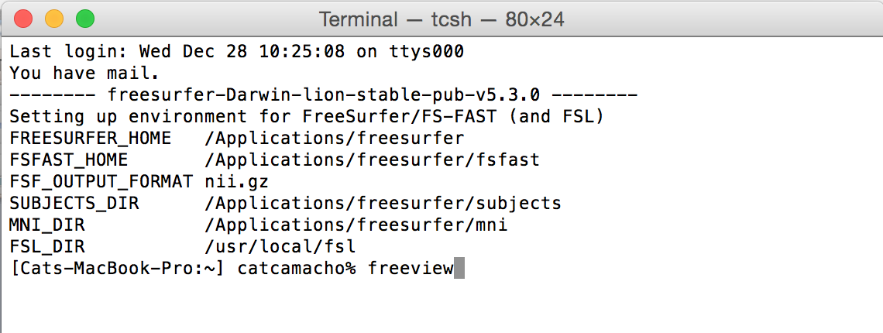
Installation
Edit your Terminal shell profile:
Open a Terminal window and type “pico .bashrc”
At the end of the file, copy and paste:
export FREESURFER_HOME=/Applications/freesurfer
source $FREESURFER_HOME/SetUpFreeSurfer.sh
Save and close.
A successful installation will look like this:
Notes:
Demo this part opening

Slide 15
FreeSurfer Environment Breakdown
FREESURFER_HOME - should point to wherever your FreeSurfer folder is located.
SUBJECTS_DIR - default output folder for processed data (each script in the class bin modifies this)
Usually left at default:
MNI_DIR
FSL_DIR
Not relevant for this class- these are both for fMRI processing:
FSFAST_HOME
FSFAST_OUTPUT_FORMAT

Slide 16
Using the Terminal
Commands are a combination of the command name, flags, and arguments
For example:
recon-all -s Sophie -i /Users/myelin/Desktop/FS_Class/raw/Sophie/Sophie_T1w_1.nii.gz -all
This tells the Terminal that you want to use the “recon-all” command on a specific subject (-s flag) named Sophie (-s flag argument) and that Sophie’s raw data input (-i flag) is located at /Users/myelin/Desktop/FS_Class/raw/Sophie/Sophie_T1w_1.nii.gz (the -i flag argument).
The “-all” flag instructs FreeSurfer to go through all of the recon-all pipeline.

Slide 17
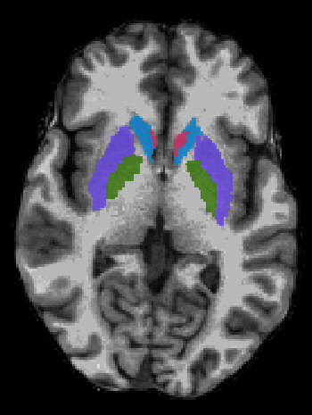
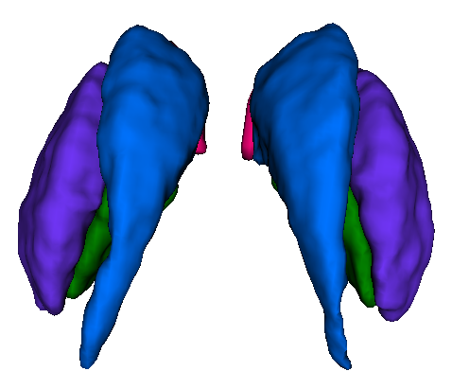
Recon-All Components
Autorecon1
Initial image processing
Autorecon2
Brain segmentation
Autorecon3
Cortex parcellation
*the default usage runs through all three
Wiki Page:
https://surfer.nmr.mgh.harvard.edu/fswiki/recon-all
Input/Output Table: https://surfer.nmr.mgh.harvard.edu/fswiki/ReconAllTableStableV5.3
Notes:
Walk through both the wiki page and the dev table

Slide 18
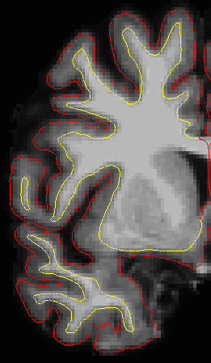
Advantages
Freesurfer uses region, boundary, and contrast based decision-making
In other words, it takes multiple features of the tissue into account to determine gray versus white matter, different regions, etc.

Slide 19
Limitations
FreeSurfer was not made for young children
The younger the sample, the more editing you’ll likely have to do.
Not recommended at all for <2 years old
FreeSurfer is intended for (adult) T1w images
Assumes a discernible difference in contrast between white and gray matter such that white matter is significantly higher signal than gray matter.
FreeSurfer assumes clear boundaries between skull, dura, and cortex
How do I know freesurfer is right for my data?

Slide 20
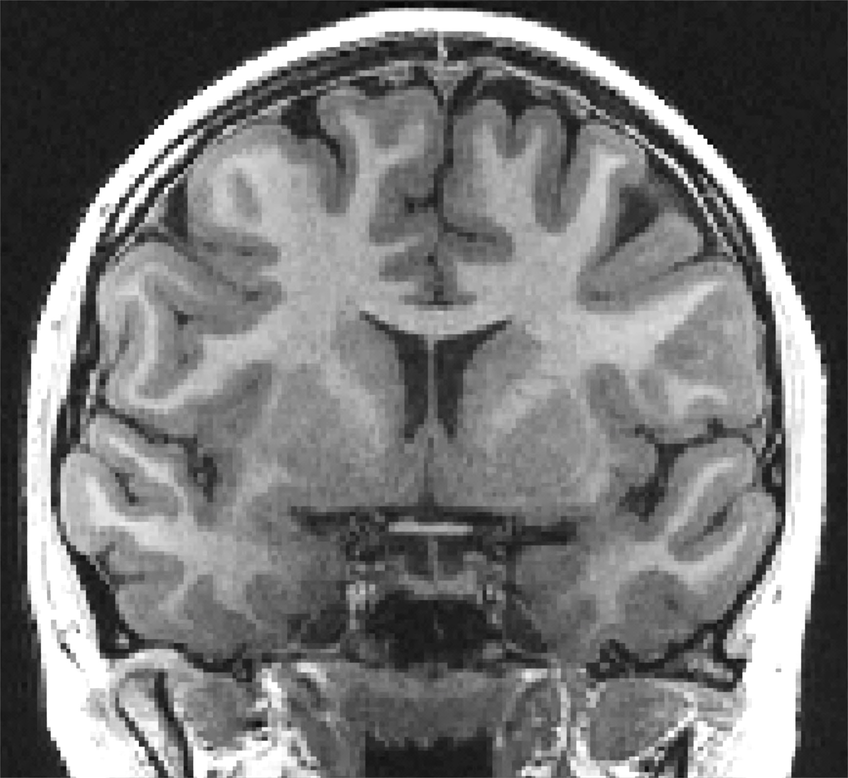
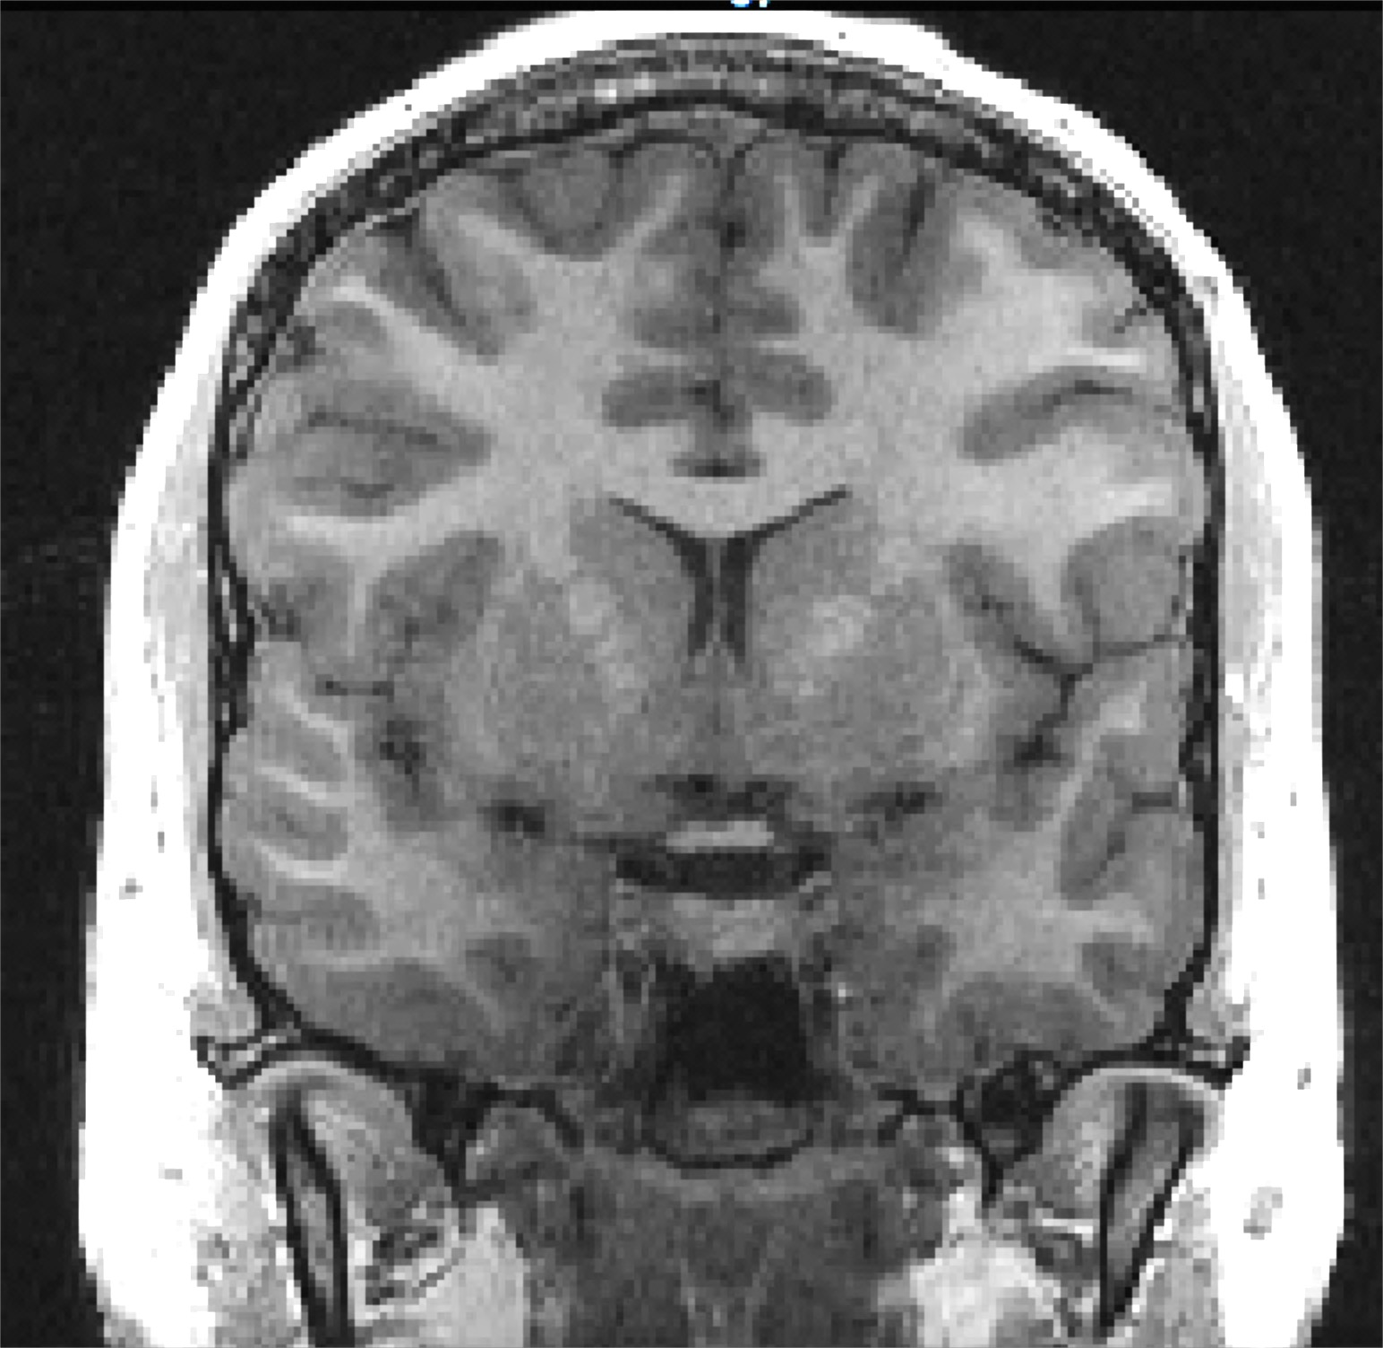
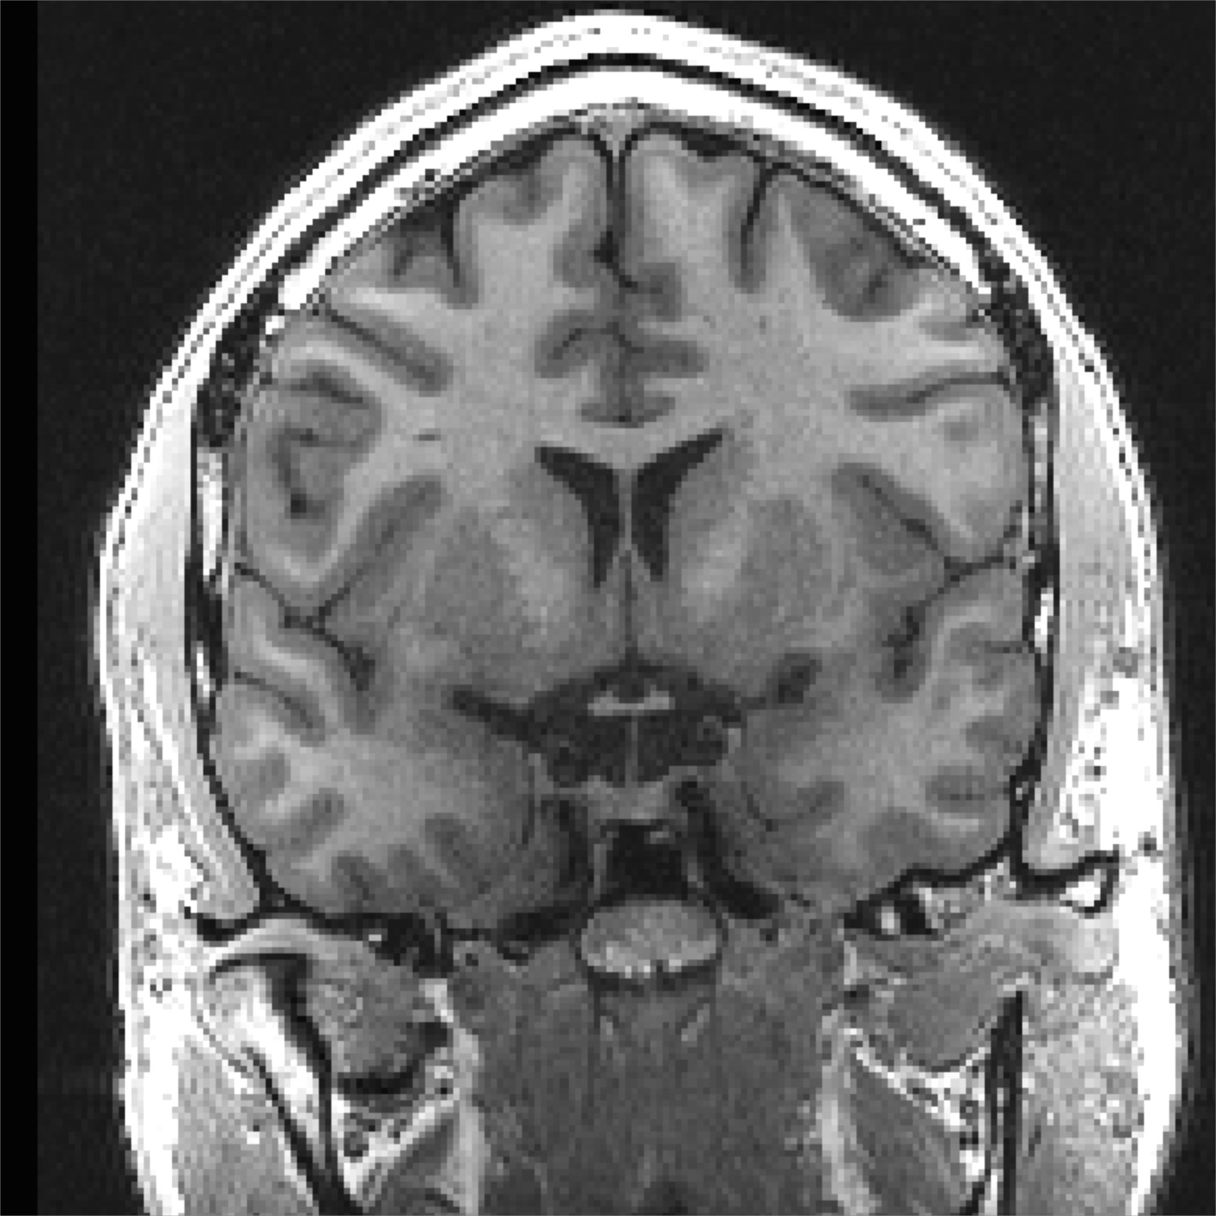
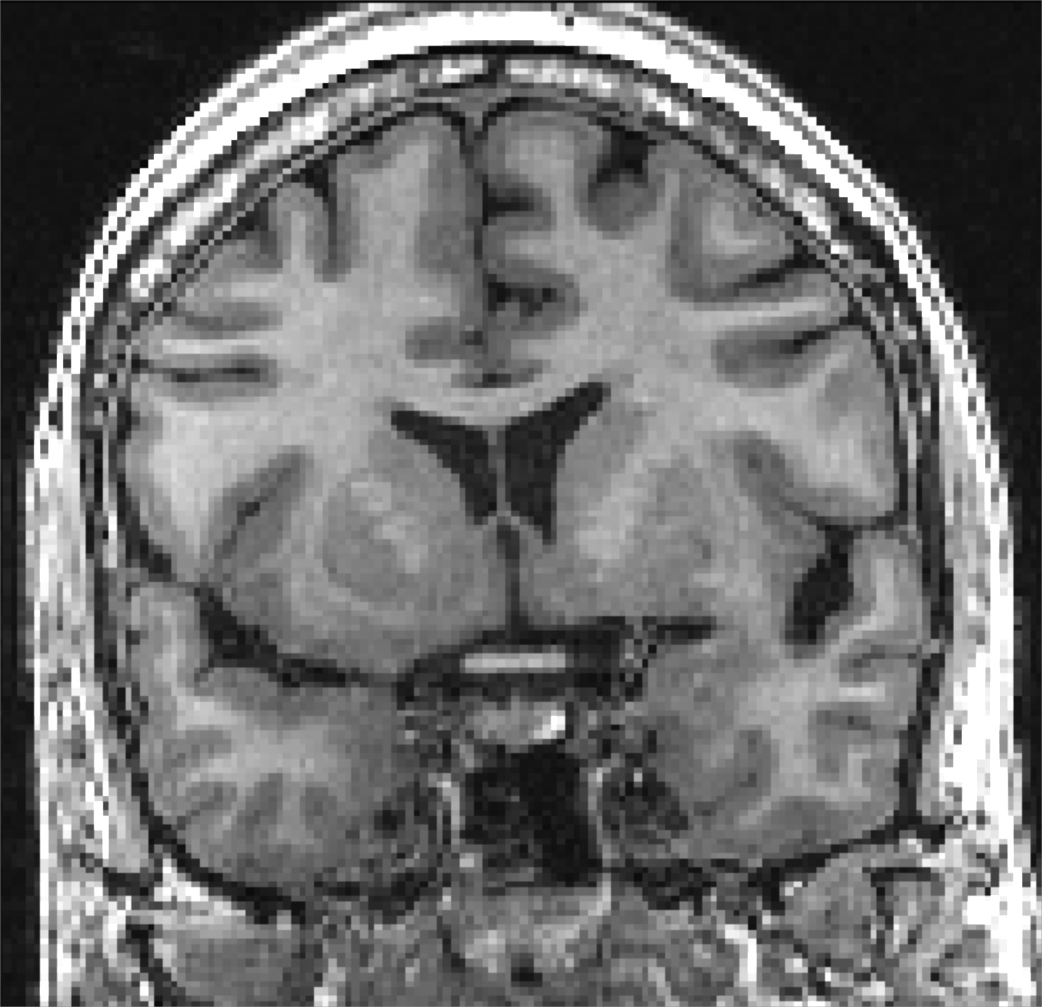
What that means: Data Considerations
Sample Age
FreeSurfer was optimized for adult data
Adult T1w brains typically have:
Higher white matter/gray matter contrast
Wider gap in brain to skull and gyrus to gyrus
Clearer region boundaries (brains are done developing)
Fewer motion artifacts
9 year old
15 year old
32 year old
53 year old

Slide 21
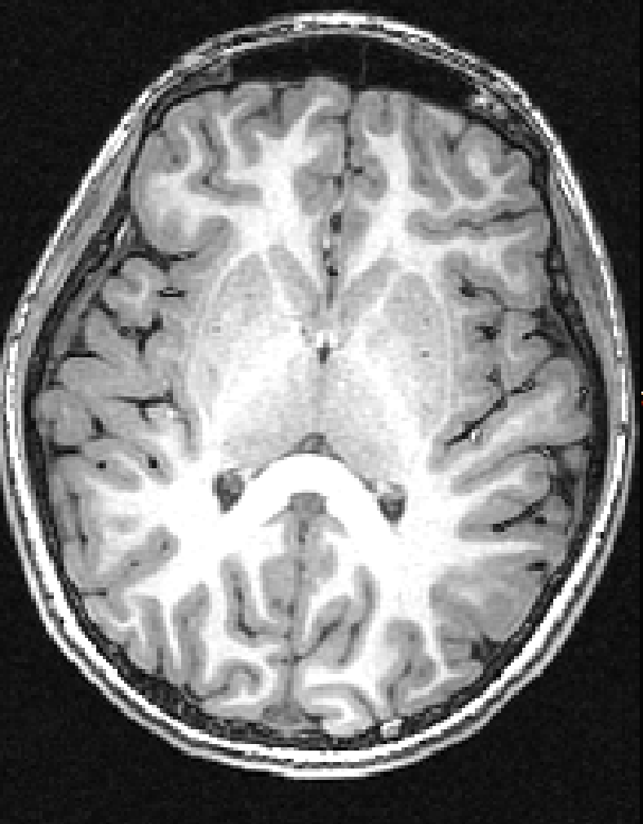
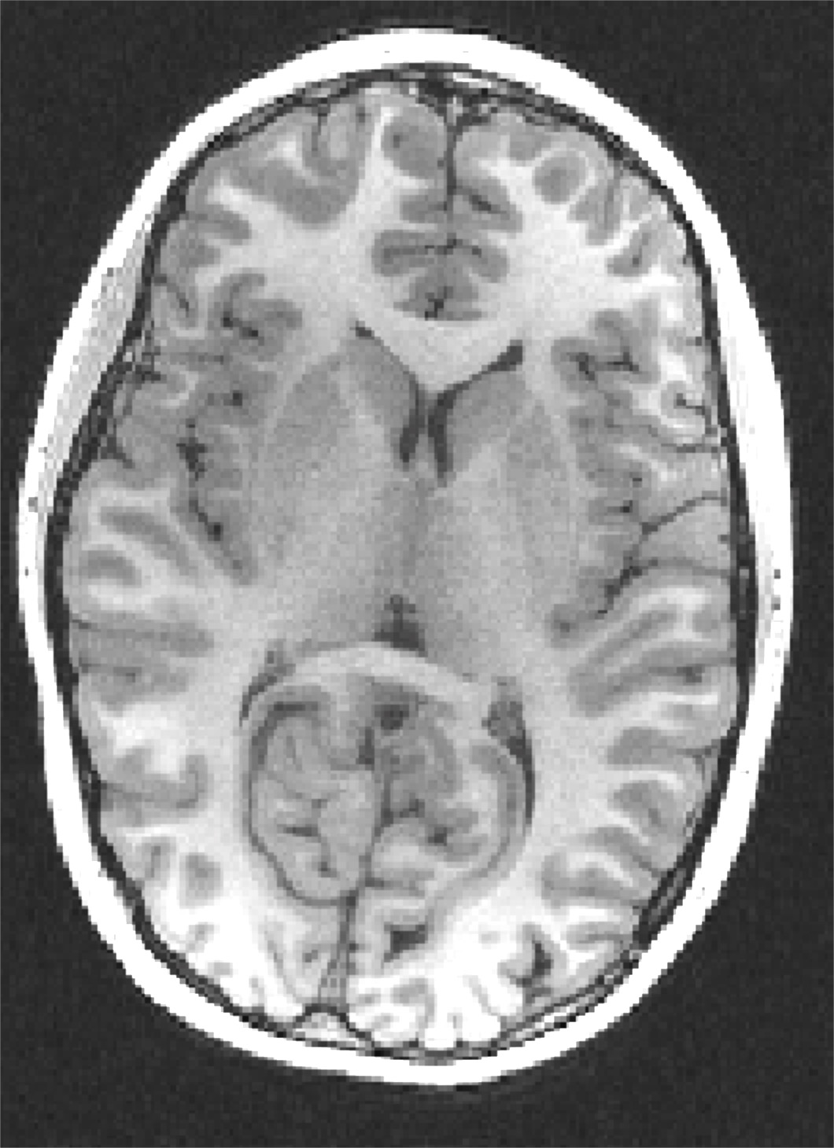
More Data Considerations
Data Acquisition
Scanner sequence PSD affects contrast
Raw Image Quality
If you can’t see boundaries, neither can FreeSurfer
3D FSPGR
3D BRAVO
Longer acquisition but clearer image
Shorter acquisition but more sensitive to artifact interference (e.g. head placement)

Slide 22
Resource Considerations
Time:
Recon-all typically takes 8-14 hours to run start to finish
Manual editing increases this time (more on this next time)
Computing resources:
When running, FreeSurfer uses 1 core of processing
Works best with at least 4GB of memory
Each subject is <1 GB of space
Notes:
100 subjects running in 10 parallel jobs would take 80 -140 hours to run and occupy ~10 cores
100 subjects would take 60-80 GBs of hard drive space

Slide 23
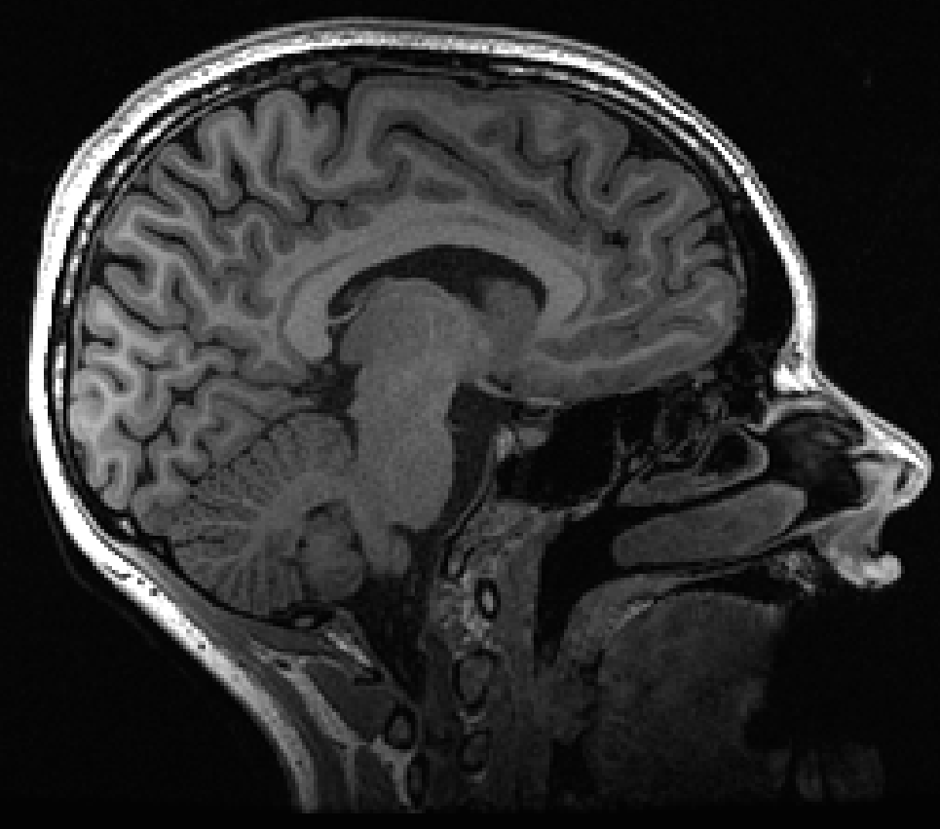
Let’s start with 1 subject
Monica’s Brain
No/low motion
Clear boundaries
Good head placement
No obvious artifacts
Good sequence choice
We’ll run her brain through the fully automated pipeline and work through the outputs throughout the class.

Slide 24
Ready?
To do list for next class (week after next):
Install/setup FreeSurfer
Download the class materials
Process Monica’s brain through recon-all (~12 hours)
Email the list if you run into issues! We’ll go over the outputs in more detail next time.
TCSH Example:
>> setenv SUBJECTS_DIR /home/catcam1/FS_Class/subjDir
>> recon-all -s Monica -i /home/catcam1/FS_Class/raw/Monica/Monica_T1w_1.nii.gz -all
BASH Example:
>> export SUBJECTS_DIR=/home/catcam1/FS_Class/subjDir
>> recon-all -s Monica -i /home/catcam1/FS_Class/raw/Monica/Monica_T1w_1.nii.gz -all

